Slide 1


Media Engagement Strategy and Proposal
Rocio J Blanco
ESOC480
17 APR 2022

Slide 2
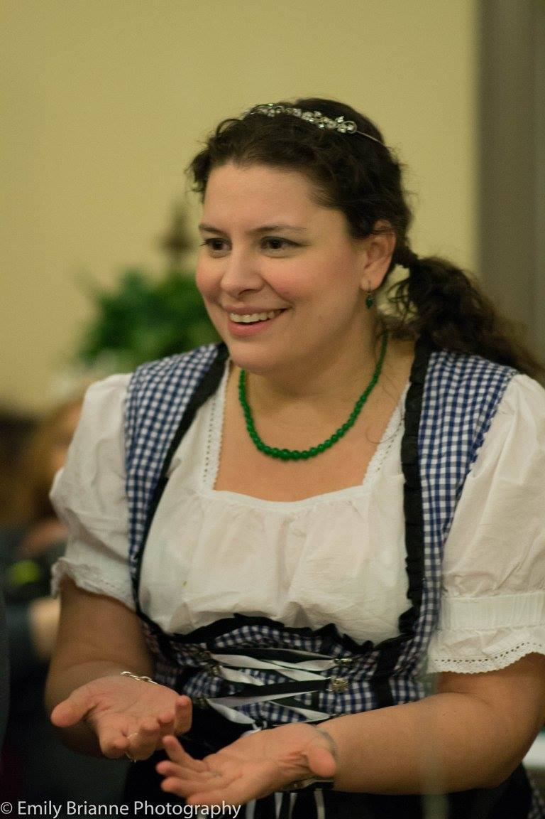
The way to get started is to quit talking and begin doing.
- Walt Disney

Slide 3



Goals
To provide a creative writing outlet for me and to relieve stress.
To attract the attention and hopefully, the guidance of the literary community.
To add my voice to the blogosphere.
To help create or join a network of writers who encourage and celebrate each other.

Slide 4
Success Benchmarks
1
2
3
4
MILESTONE
MILESTONE
MILESTONE
MILESTONE
Gain 100 Followers on each social media stream to include Good Reads, Facebook, and Instagram
Receive at least 10 comments on each post consistently. Earn 50 likes on posts consistently.
Attract positive attention from the literary community and obtain guidance from mentors.
Find and collaborate with a good literary agent to start working on publishing my works.

Slide 5

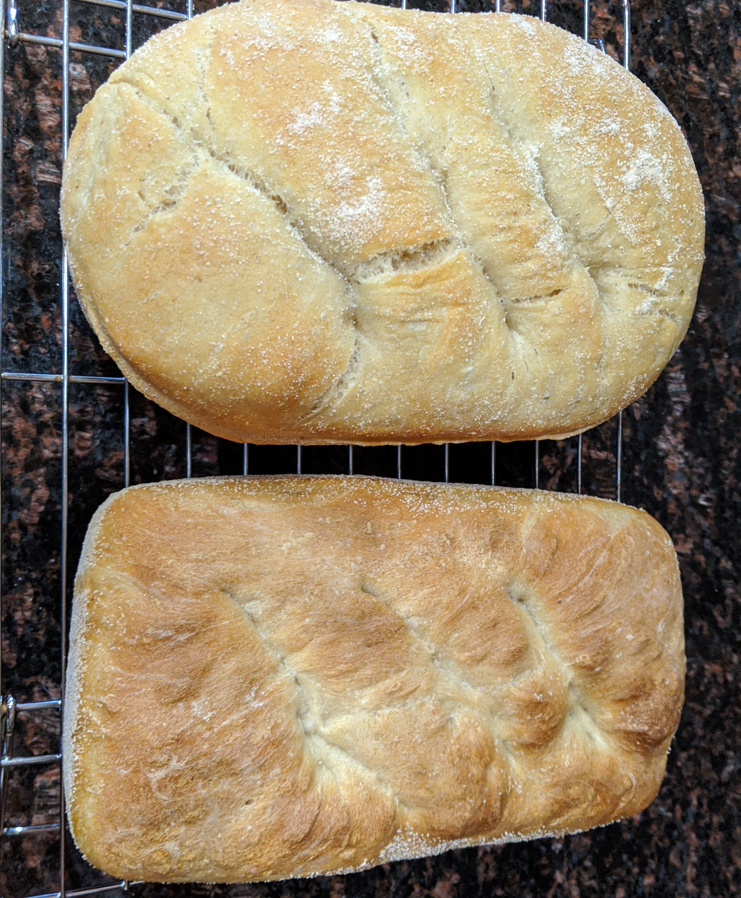
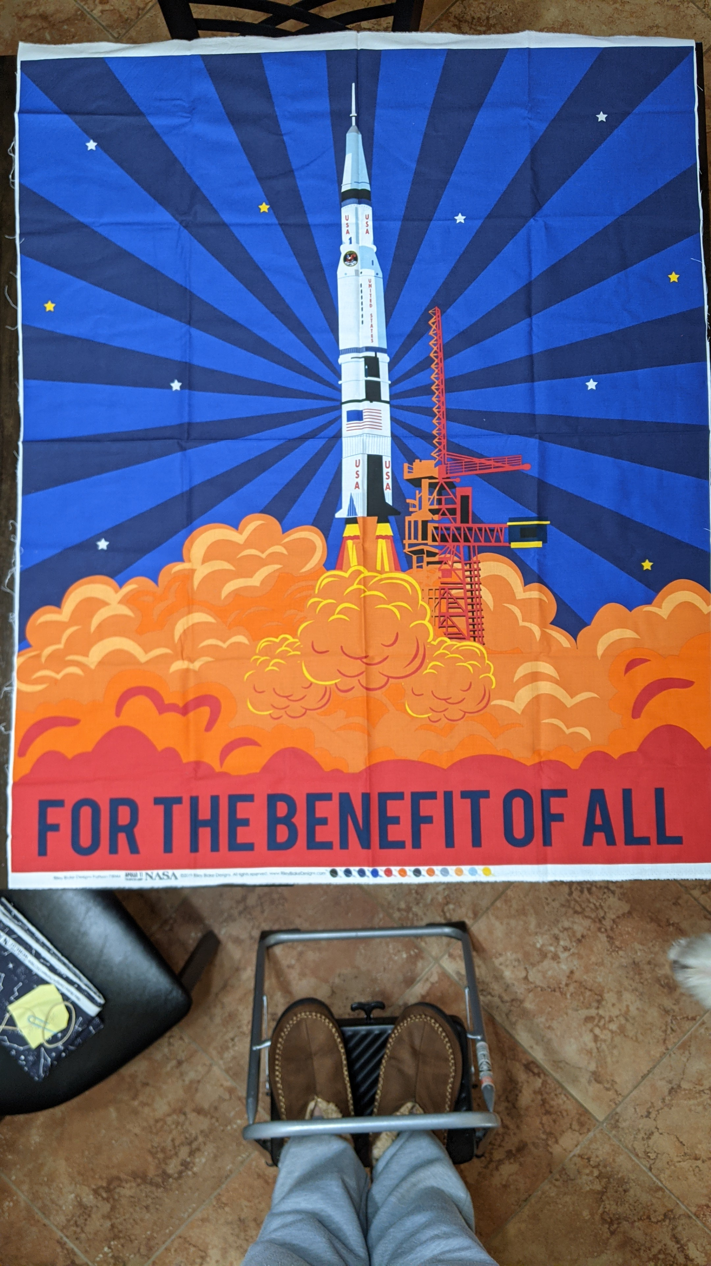
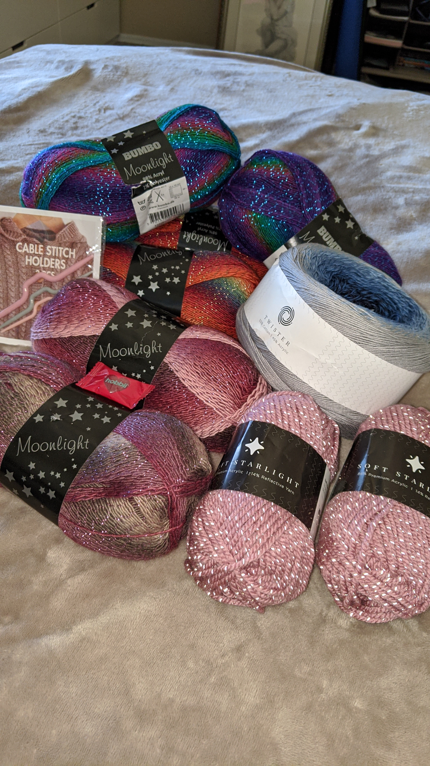
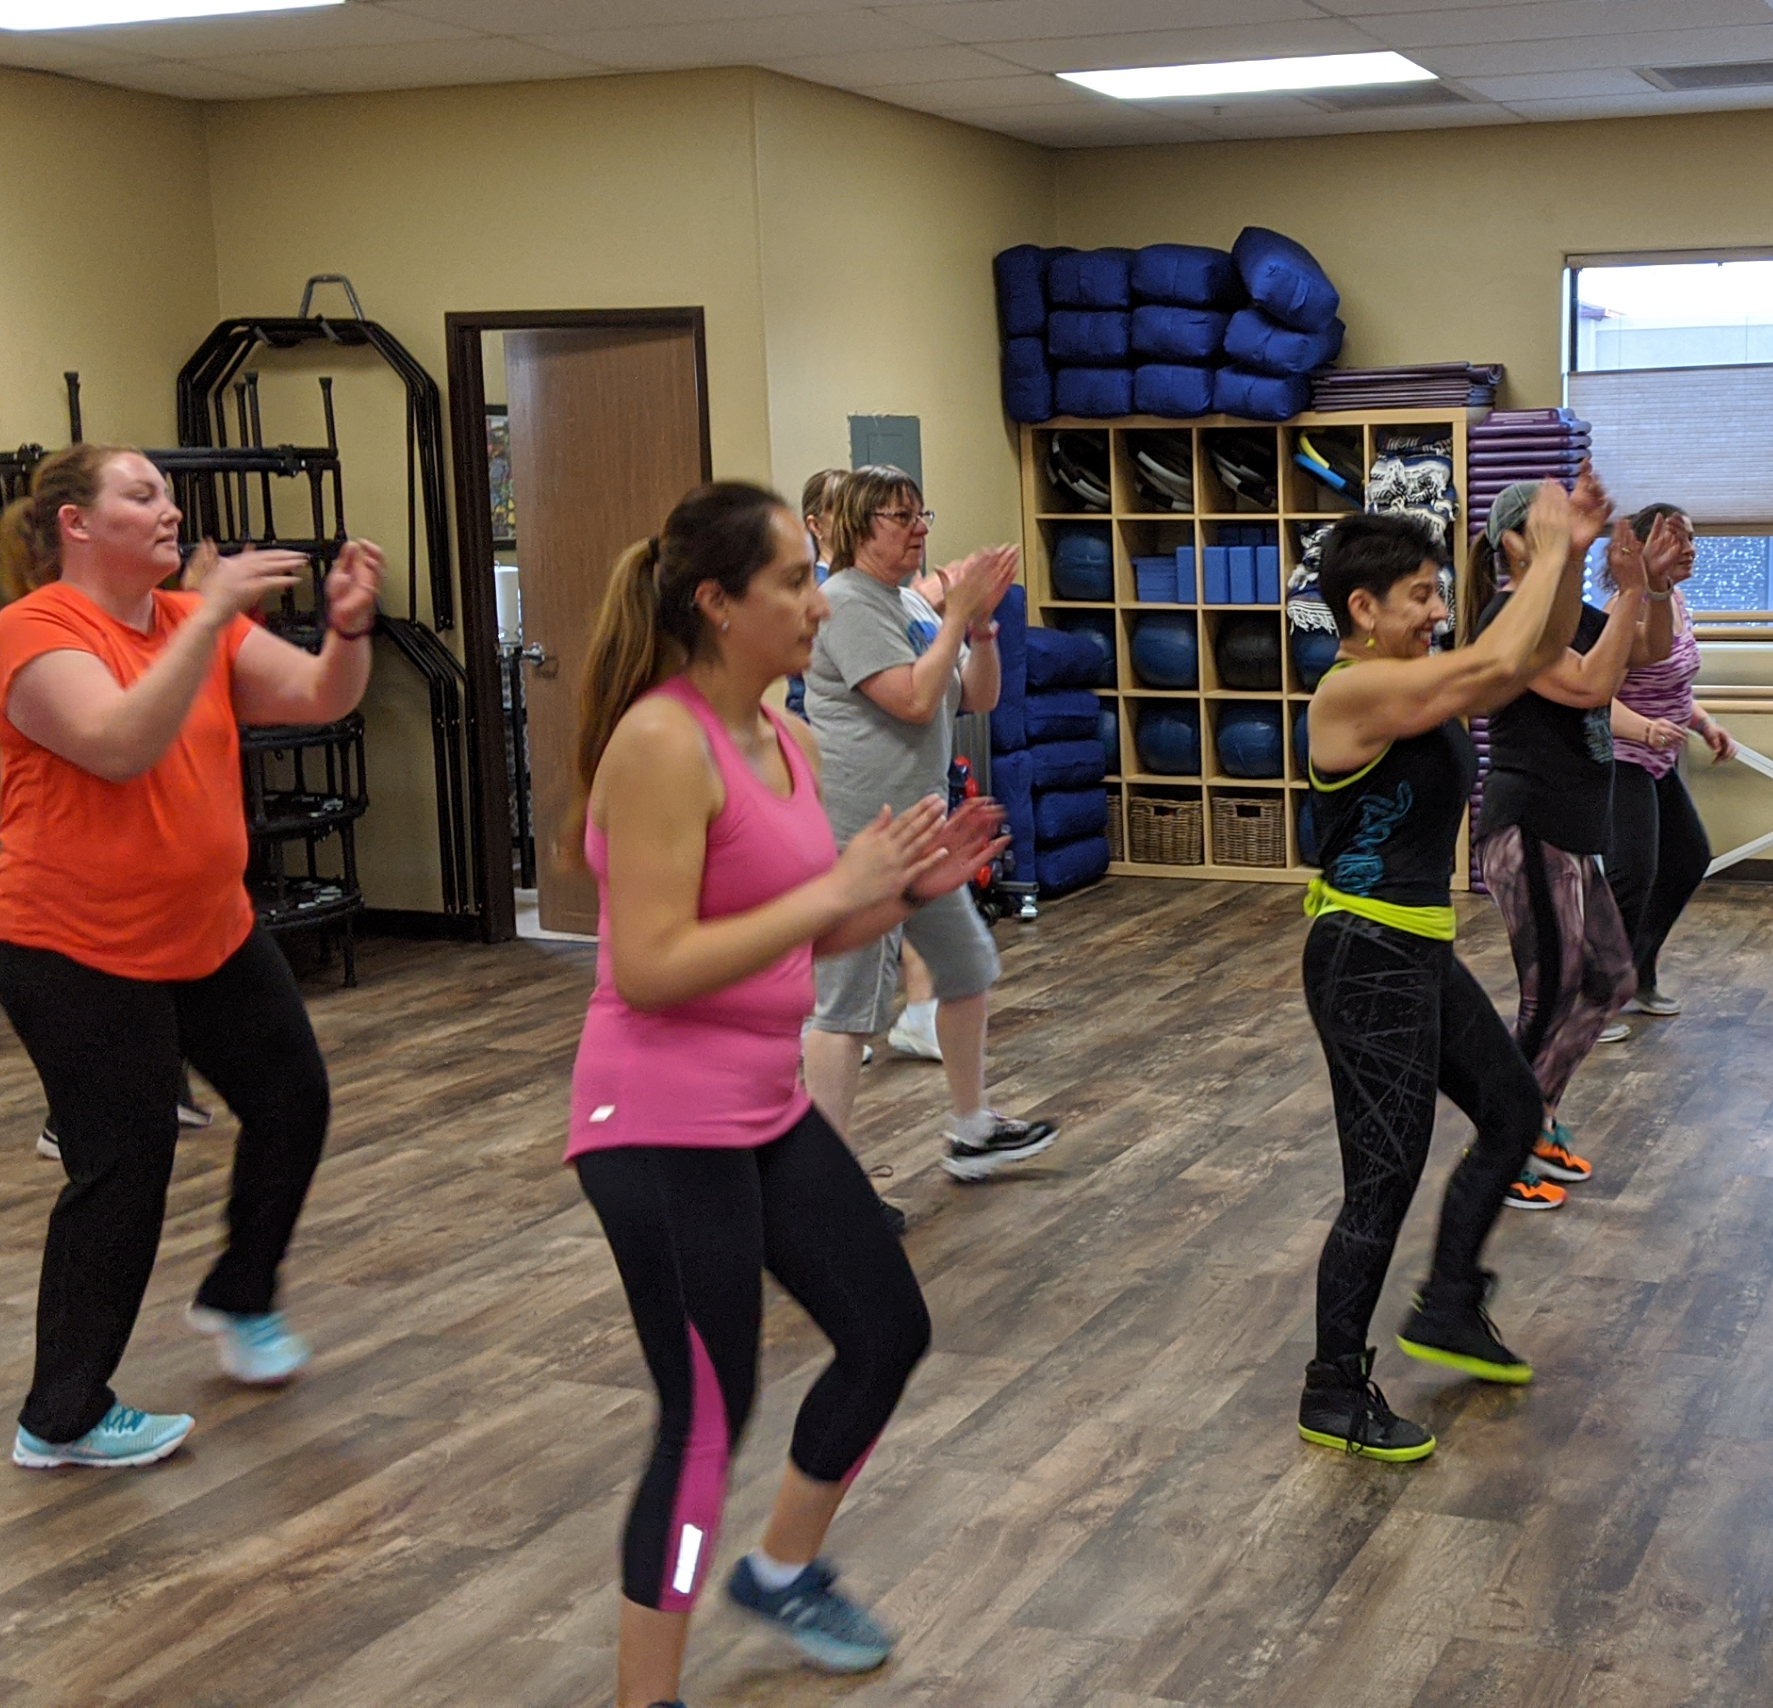
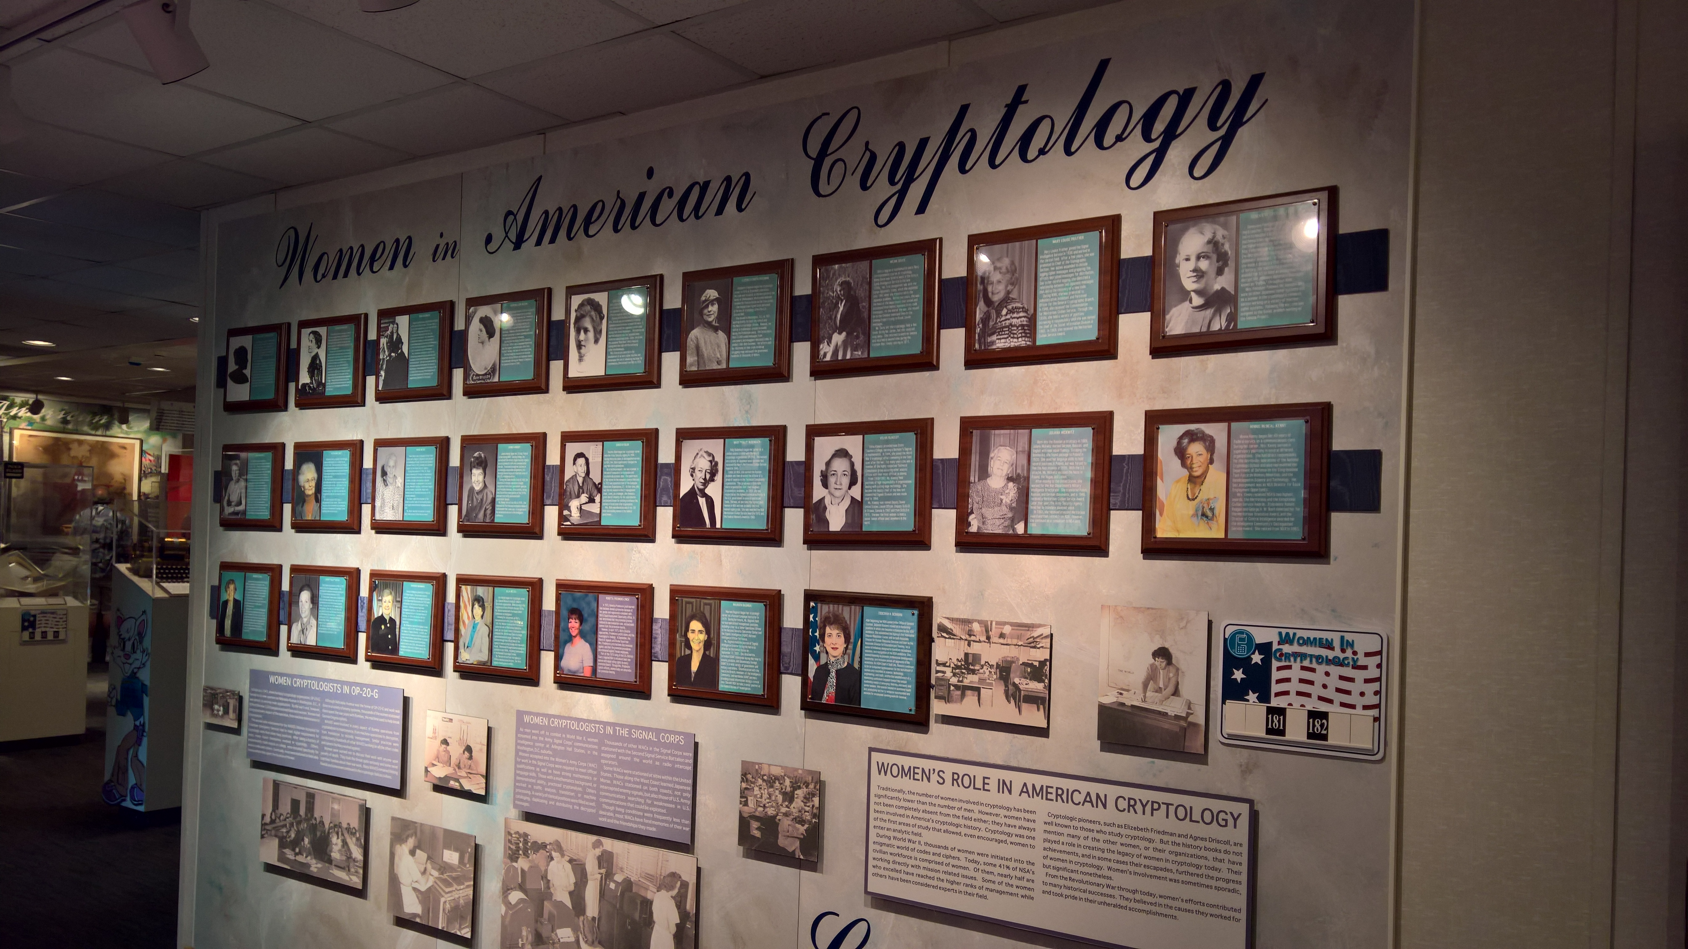

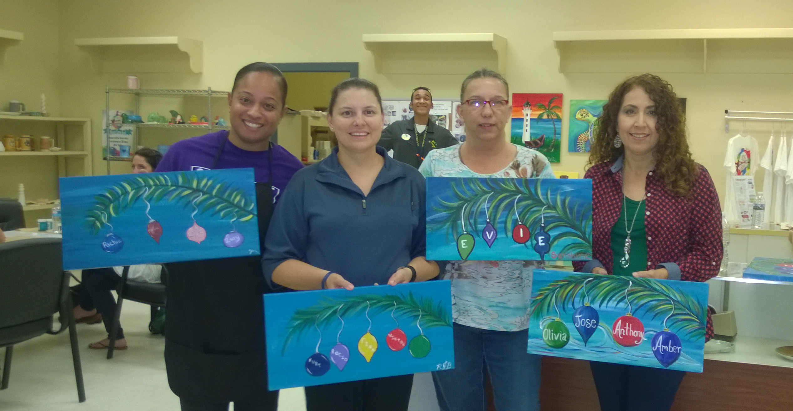
Audience demographics
Books
Languages
Recipes, food,
&
Restaurants
Fiber Arts
People who can relate to some of my hobbies and experiences.
People who are interested in knowing or considering my point of view.
People who are interested in my writing.
Friends, family, colleagues, and fellow geeks. <3
Age, gender, ethnicity, etc. are irrelevant here because ALL persons are welcome to peruse my work.
Space
Women in STEM
Zumba & other Fitness
SCI-FI, Fantasy, games, & other geekery
Female
Veterans
Painting

Slide 6

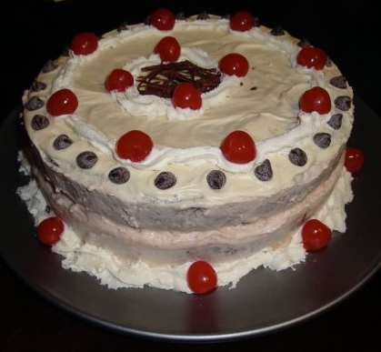
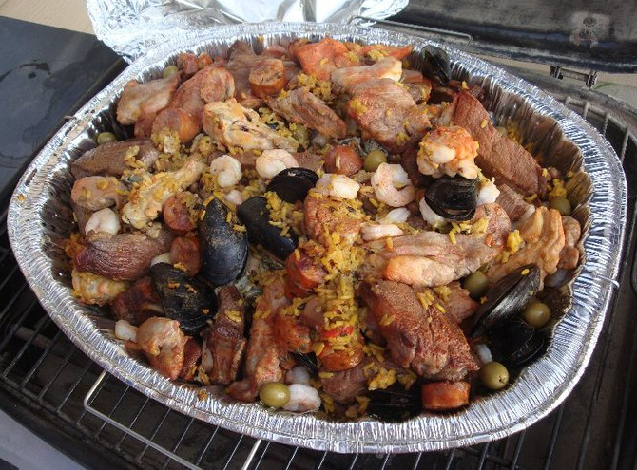
Sample Work
COLOMBIAN PAELLA
BLACK FOREST CAKE
My Where I’m From Project
Here is my final multimedia project from ESOC 300 Digital Storytelling. It is a quasi-poetic summary of my life thus far.
https://youtu.be/Rhn2NZwxmJA

Slide 7

Sample Work
Book Review: The Staycation by Michele Gorman
This delightful jaunt begins in a crowded airport and centers on two British families who are trying to get to Italy for a holiday, or as Americans might say, a vacation. Unfortunately, thanks to an ash cloud, their flight is cancelled, and they are faced with having their hopes for time away from home being dashed. As they are introducing themselves and lamenting their similar fates to each other, they brilliantly come up with the idea to switch houses for the two weeks instead of going home disappointed. Yes, I realize this sounds like that lovely movie called The Holiday where Cameron Diaz and Kate Winslet switch homes for the holidays, but since this deals with two families rather than two single women, the trappings and issues are quite a bit different. Like the movie, however, the story does focus on the two women’s issues more than anyone else’s and is definitely worth consideration.
In fact, Gorman expertly reveals the key characters in the story like peeling away the layers in an onion, slow enough that the reader has time to add each new tidbit of information but not so much to slow the story down. There are plenty of hilarious twists, some of which involve animals, throughout the novel, but there are also a couple of points of serious commentary that are reflective of modern times folded into the story. All in all, I would say this is a balanced tale that may just inspire readers to seriously consider their familial relationships. Fantastic read for sure!
https://fabulousbutterfly.com/2020/10/04/book-review-the-staycation-by-michele-gorman-published-by-hachette-uk-july-23-2020/

Slide 8

Sample Work
Restaurant Review: Tropical Smoothie Café Opens in Vail, AZ!
About a week ago, a new purveyor of delicious treats, squeezed between the Dunkin’ and the Auto Zone in Houghton Town Center, quietly opened to little fanfare. With roots in sunny Florida, this lovely little café is yet another location for Tropical Smoothie Café. Although there are over 700 locations nationwide, this is a welcome addition to the shopping center offering fruity drinks, toasty sandwiches, wraps, and bowls and more for breakfast, lunch, or even a light dinner. While it does offer some stiff competition to recently opened Eegee’s in the same shopping center and to Dutch Brothers across the street, there is plenty of room for everyone in this blooming market.
The food offerings range from a tantalizingly decadent Peanut Butter Banana Crunch Flatbread to the wholesome and delicious Thai Chicken Bowl. There are even treats for the younglings including wholesome sides of fruits, chips, or even a bright kale and apple slaw. The smoothies also range widely from purely delicious to super healthy green shakes, but all are made with wholesome and fresh ingredients. For a real bang for your caloric buck, try the chicken pesto wrap which is grilled to perfection! Wash it down with a summery Blimey limey smoothie and you will not only satisfy hunger as well as cravings, your body will thank you for the healthy boost to boot.
Aside from the great food values, this location also features great customer service and pandemic-related considerations. The staff is polite and quick. They epitomize teamwork and are all wearing masks. So, what are you waiting for? Grab your mask, jump in your vehicle, and hit up the drive-through of the brand-new Tropical Smoothie Café located at 10230 E Old Vail Rd. or download their app and skip the line.
See http://www.tropicalsmoothiecafe.com for nutritional information and store hours.
https://fabulousbutterfly.com/2020/09/28/tropical-smoothie-cafe-opens-in-vail-az/

Slide 9

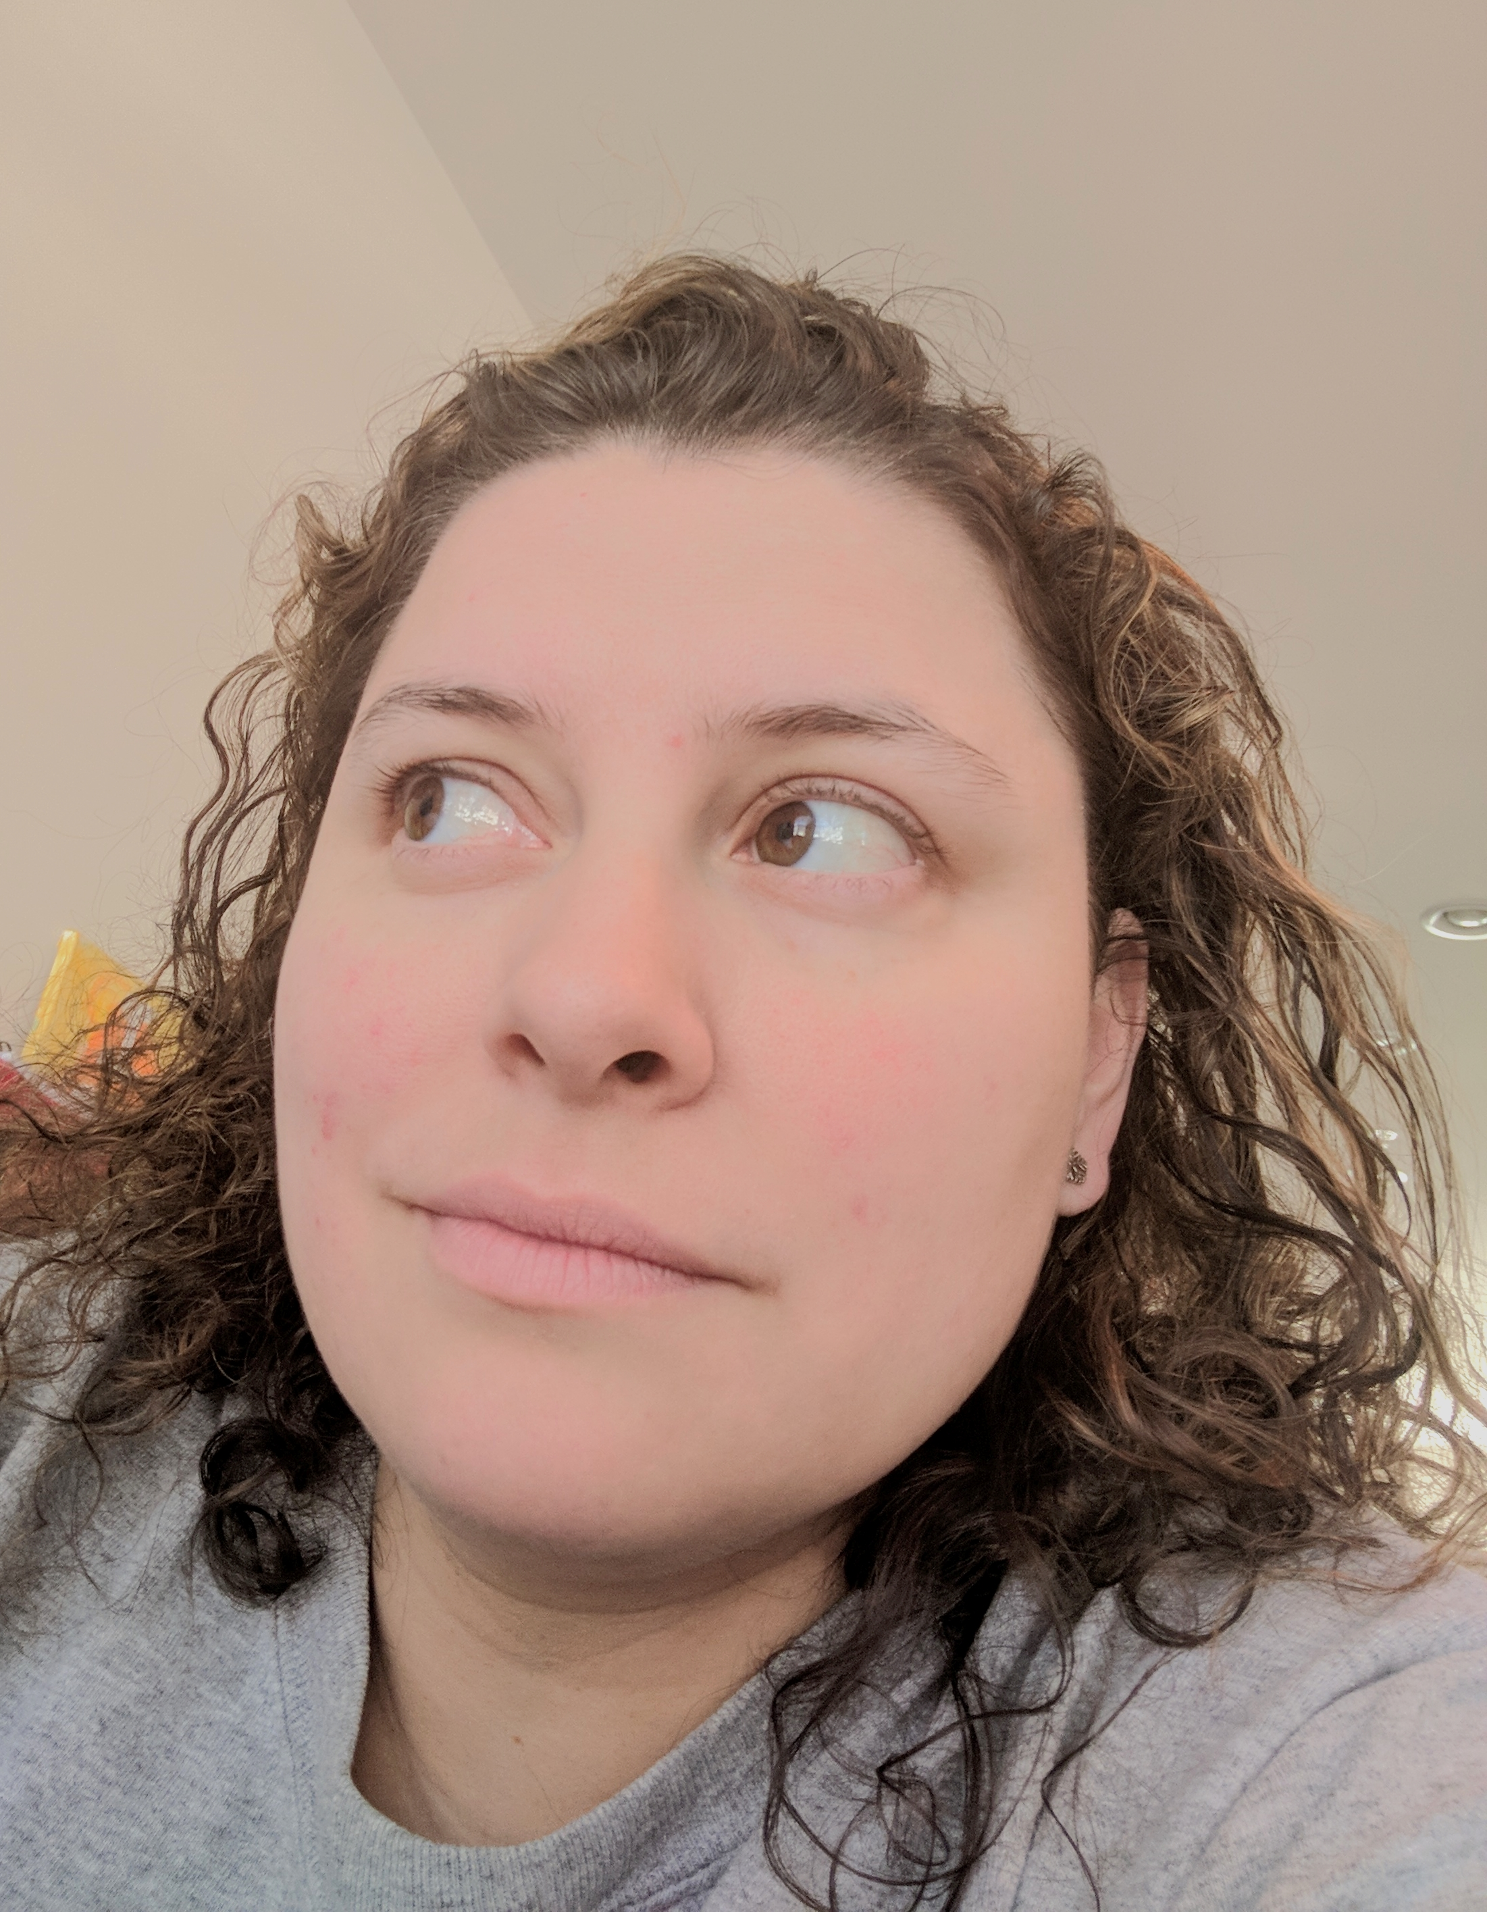
Content Strategy
1
A new post will be published every 2-3 days for the foreseeable future. Consistency in frequency of posts is key. The posts will include relevant hashtags and links.
2
3
Metrics will be tracked using systems embedded in the social media accounts. This will help track the Engagement rate which is the number of likes, comments, and saves added up and divided by Impressions times 100.
4
5
Virtual and live events and giveaways can be organized and scheduled later once the audience has been further established.
Changes to the media strategy will be considered quarterly. Depending on which posts succeed and which remain stagnant, changes to topics might be considered.
Each new post will be announced and linked on Instagram, Facebook, and Good Reads. These posts will also include relevant hashtags and links.

Slide 10
Sample Calendar
SUNDAY | MONDAY | TUESDAY | WEDNESDAY | THURSDAY | FRIDAY | SATURDAY
Book Review Post 1 | 2 | 3 | Recipe Post 4 | 5 | Restaurant Review Post 6 | 7
8 | Book Review Post 9 | 10 | Essay about RADM Grace Hopper 11 | 12 | 13 | Knitting Work in Progress 14
15 | 16 | Arizona Sunrise Painting 17 | 18 | Restaurant Review 19 | 20 | 21
Book Review Post 22 | 23 | 24 | Quilt in Progress 25 | 26 | Recipe Post 27 | 28

Slide 11







Thank You
Mrs. Rocio J Blanco, USNR (RET)
fabulousbutterfly@hotmail.com
www.fabulousbutterfly.com
Good Reads: Rocio Blanco
Instagram: @fabulousbutterfly1
Facebook: fabulousbutterfly1

